Slide 1
Electronic Healthcare Systems
by
Shayan Taheri
University of Central Florida
Orlando, Florida
Fall 2015

Slide 2
Overview
Introduction
Electronic Healthcare System
Security of Electronic Healthcare System
Implementation of A Security Technique

Slide 3

Introduction
Telecommunication Network
Linkage of a number of terminal nodes, such as computers, devices, and other networking hardware
Enabling telecommunication between these nodes through Transmission Link
Providing access to information on shared storage devices
Allowing sharing of data and computing resources

Slide 4
Introduction …
Transmission Link
The connection between two or more nodes
Passing a signal data from a source terminal node to a destination terminal node
Terminal Node Address
Usage: For routing the messages and connections
For each node → Having a unique address
Address Space = Collection of terminal node addresses in a network

Slide 5

Introduction …
Graph for network terminal nodes
Specification Differences of Networks
Transmission Media → For carrying signals
Communication Protocols → For organizing network traffic
Network Size → The number of terminal nodes in a network
Topology → Diagram of the connection of network nodes

Slide 6
Introduction …
Usage of Networking Software Applications
Retrieving formatted electronic documents
Allowing interaction between all of the computers and devices
Performing authentication process between users
Electronic Network Architecture
A bridge between users and related software and hardware
Client-Server → A software architecture model consisting of two parts:
Server → A powerful computer or device for managing network acccesses
Client → A personal computer or device that communicates with server in
order to acquire data or request certain services

Slide 7

Electronic Healthcare System
Electronic Health (e-Health) System
Referred to as healthcare actions that are supported by electronic and communication processes
Collection of patient health data through electronic devices (e.g. PC)
Easy deliver of data to the healthcare providers
Electronic Heath Record (EHR) → The main basis of this technology

Slide 8


Electronic Healthcare System …
Mobile Health (m-Health) System
A developed version of e-Health system
Data collection through mobile devices along with other electronic devices
Improvement in supporting cyber healthcare actions:
Real-time monitoring of patient health data
Direct provision of health care

Slide 9

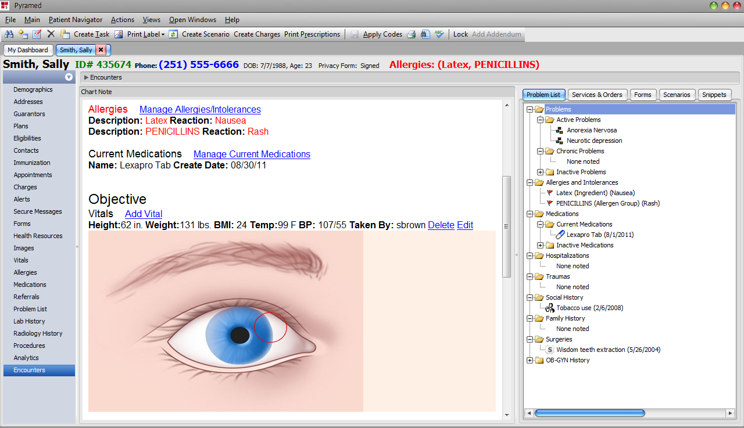
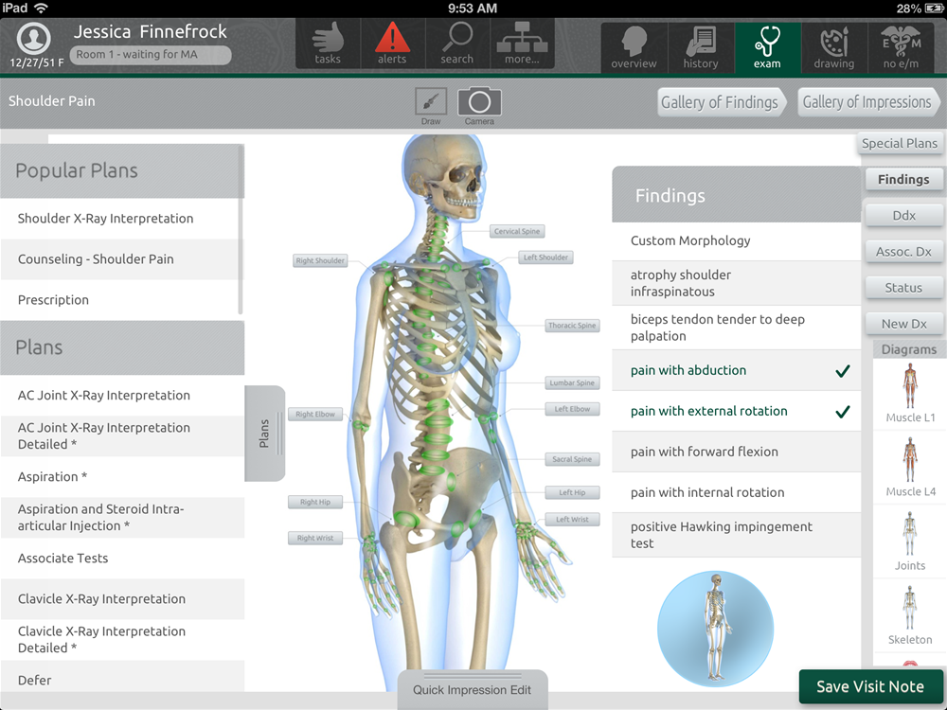
Electronic Healthcare System …
Electronic Health Record (EHR)
Store of patient health information in a digital format
Systemizing collection of health data
Provision of the possibility to share medical records across a network

Slide 10
Electronic Healthcare System …
Possible Information in Electronic Health Record
Medical History
Diagnosis Report
Medications
Treatment Plans
Health Information Network
Creating, gathering, and managing health data should conform to nationally recognized interoperability standards
The data processing can be done by multiple healthcare organization
Maintaining and updating EHRs can be done only by healthcare providers
Possible Users → Patient, Physician, Nurse, Hospital, Pharmacy, Laboratory,
Ambulance, and Health Insurance Company
Immunization Dates
Allergies
Radiology Images
Laboratory and Test Results

Slide 11
Electronic Healthcare System …
Superiority of e-Health System over Traditional Medical System
Time Benefits
Spending more time for direct patient care
Reduction in documentation workload of patient health information
Finding, tracking, and accessing patient health information at any time
Real-time updating patient health information
Financial Benefits
More net savings for healthcare providers
Requiring a single free to create file for all of the health information
Reducing the possibility of information replication and loss

Slide 12
Electronic Healthcare System …
Superiority of e-Health System over Traditional Medical System …
Environmental Benefits
Less usage of paper
Alleviating transportation traffic load
Sharing and using the EHRs at any given geographic location
Health Benefits
More accurate and faster diagnosis and treatments
Increasing the accuracy and legibility of health information
Reducing the occurrence of medical errors
Better care coordination among healthcare providers

Slide 13


Electronic Healthcare System …
Risks and Concerns in Using e-Health System
Emersion of malignant and non-malignant errors due to software bugs
Occurrence of catastrophic incidents due to existence of highly coupled systems
Privacy and Security Issues
Leakage of information
Creation of new cyber attacks and vulnerability of existing systems

Slide 14
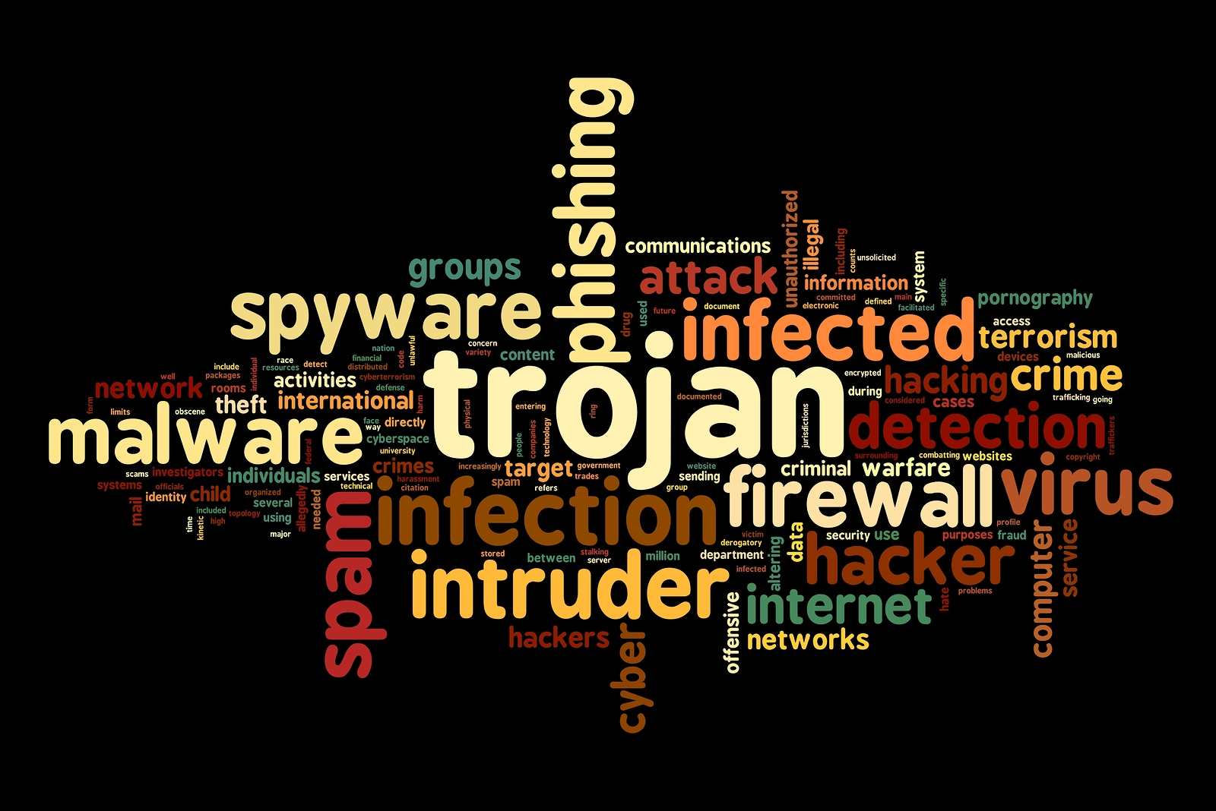
Security of Electronic Healthcare System
Privacy and Security Issues of e-Health Systems
Privacy of User Identity
Integrity of Data
Authentication
Access Control
Secure Data Transmission
Ability to Inspect Data Usage

Slide 15
Security of Electronic Healthcare System …
Possible Attacks
Impersonation Attack
An attack in which an adversary successfully purports the identity of one of the legitimate users in a network
Eavesdropping Attack
Unauthorized monitoring of the communication of valid users in a network in order to access and manipulate information
Tracing Attack
Enough collection of information by a malicious person in order to find
a particular real identity based on their relationship

Slide 16
Security of Electronic Healthcare System …
Possible Attacks
Insider Attack
An attack on a network by a malicious and valid user who has authorized network access
Insider Attackers Vs. External Attackers
Having authorized network access
Being familiar with network architecture and system policies
Less security attention and concern on them
Collusion Attack
Construction by multiple adversaries (from inside, outside, or both) for
a valid user or organization in a network

Slide 17
Security of Electronic Healthcare System …
Possible Attacks
Electronic Health Record Leakage and Loss Attack
Accidental or malicious transmission or quit of EHRs from within
a network to an outside destination either electronically or physically
Usage of leaked data for malicious purposes
Cloud-based m-Health systems can highly be vulnerable to this attack
Unique Identification Attack
Phase 1 → Capturing the “unique information” of a particular entity in
an organization, hospital or etc.
Phase 2 → Finding and revealing the entity’s identity

Slide 18
Security of Electronic Healthcare System …
Possible Attacks
Phishing Attack
Sending out legitimate-looking messages to victims by adversaries in order to gather personal, financial, and other sensitive information
The messages seem to come from trustworthy authorities, organizations, hospitals, and etc.
Future Trend → Smarter adversaries and more dangerous payloads !

Slide 19
Security of Electronic Healthcare System …
Possible Countermeasures
Securing communication channels using Cryptography techniques
Targeting Impersonation and Eavesdropping Attacks
Detecting unwanted data alterations using Watermarking techniques
Targeting Insider Attack
Management and transmission of sensitive information through covert communication channels
Targeting EHR Leakage and Loss and Unique Identification Attacks
Automatic shut down mechanism for stolen devices
Targeting EHR Leakage and Loss Attack

Slide 20
Security of Electronic Healthcare System …
Possible Countermeasures
Direct and limited exchange of information between users by Distributed Attribute-Based Cryptography techniques
Targeting Tracing Attack
Monitoring and controlling creations of, accesses to, and modifications on, all of the information and electronic health records
Targeting Collusion Attack
Using “Hardware Security” techniques for creation of direct authentication between the networking devices before transmission of sensitive information
Targeting Phishing Attack

Slide 21


Security of Electronic Healthcare System …
Improving Security Strength and Preventing Privacy Disclosure
Using a Cryptography technique
Cryptography → Construction of certain protocols for blocking adversaries
Purpose → Authentication for Communication and Data Protection
Mechanism → Provision of a secure communication channel
Cost → Needing more computational elements → Increase in system complexity

Slide 22


Security of Electronic Healthcare System …
Basics of Authentication Process in Cryptography
Electronic Signature
Any electronic means for indication of the ownership of a document (or
a piece of data) by a real identity
Digital Signature
Provision of assurance for validity and authenticity of a digital document
Certificate Authority → Having responsibility to provide the ability to
sign/access electronic documents to the network users

Slide 23
Security of Electronic Healthcare System …
Mechanism of Cryptography Process in Four Steps
Starting an authentication session between two users
Constructing and sending an information message by one of the users to the other one for verification
Repetition of the last step by the other user
Establishment of communication by the decision of one of them
Classification of Cryptography Infrastructure
Centralized
Usage in common m-Health systems
Not secure anymore
Decentralized → Distributed authentication by allowing direct communication

Slide 24
Security of Electronic Healthcare System …
Classification of Standard Cryptography Techniques:
Public-Key Cryptography (a.k.a. Asymmetric Cryptography)
Public Key → For encrypting the plain text
Private Key → For decrypting the cipher text
Higher security strength
Having more complicated operations
Non Public-Key Cryptography (a.k.a. Symmetric Cryptography)
Having the same key for both encryption and decryption processes
Not secure enough
Requiring additional mechanisms for access control
Better for system performance

Slide 25
Security of Electronic Healthcare System …
Identity Theft Attack
A common attack for e-Health systems
Defending Solution → Attribute-Based Cryptography
How? → Verification of EHRs without revealing patient identity
Attribute-Based Cryptography
A type of public-key cryptography
Each user → Having a certain secret key based on his/her attributes
Access policy → An access structure over the set of all of the possible attributes
Decryption → Matching between the attributes and information of a user key
and the access policy of cipher text
Identification based on a set of attributes (not by a unique string)

Slide 26
Security of Electronic Healthcare System …
Side-Channel Attack
A possible attack on cryptosystems based on the obtained information from their physical implementation
Deficiency of Cryptography
Lack of capability to protect the end points of communication channel
Result → Infection of electronic health record and other information
How to solve this problem?
Provision of transparency and reason for data usage
Finding the identity of doer of any modification on data
Solution → Watermarking Technique

Slide 27
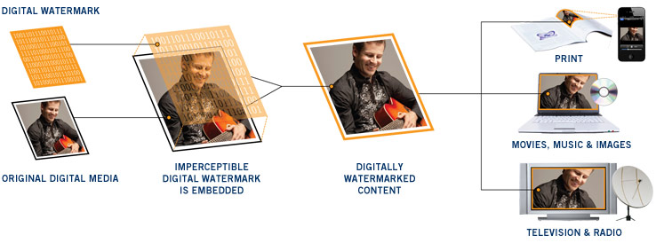
Security of Electronic Healthcare System …
Watermarking Technique: Detection of unwanted data modification
Meaning → Insertion of a mark to a design
Definition → A marker (i.e. watermark information) is embedded covertly in
a signal (or data)
Purpose → Verification of the integrity and correctness of the signal (or data)
Goal → Insertion of watermark information should not change the original
signal noticeably

Slide 28

Security of Electronic Healthcare System …
A Common Deficiency in Standard Cryptography Systems
Overlapping in accessing the information
Solution → Integrating Cloud Computing in the system
Reasons for Using Cloud Computing
Cost-Effective
Wide-Area Mobile Access
Reliability
Scalability
Elasticity and Resiliency

Slide 29

Security of Electronic Healthcare System …
Main Capabilities of Cloud Computing
Data management and storage capacity
Advanced computational resources
Challenges in Using Cloud Computing
Technical → Security, Reliability, Privacy, Scalability, and etc.
Non-Technical → Legislation and Standard, Ownership Issues, and etc.
Counterfeiting Problem in e-Health Systems → Existence of fake products
Solution → Labeling products
Example: Using radio frequency identification (RFID) technology

Slide 30
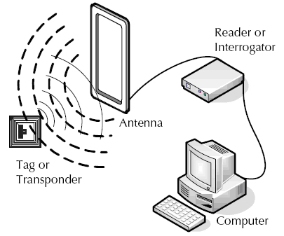
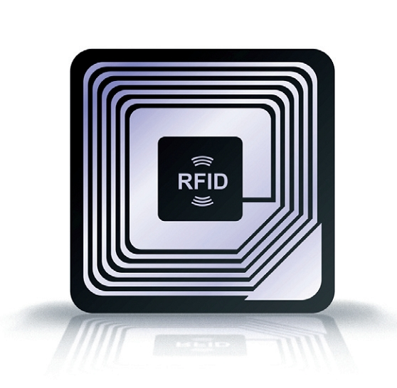
Security of Electronic Healthcare System …
Usage of RFID Technology
Labeling products using tiny chips
The chips are powered over an air interface
Employing the chips for identification and tracking products
Concerns
Scalability issues of the central database
Possibility of copying unique identification numbers of products

Slide 31
Security of Electronic Healthcare System …
Two Prominent Public-Key Cryptography Systems
RSA (Rivest – Shamir – Adleman)
Inventors → Ron Rivest, Adi Shamir, and Leonard Adleman
Security Strength → Based on Integer Factorization Problem
Deficiency
When large numbers are involved in key generation
High computation and communication costs → Low Performance
ECC (Elliptic Curve Cryptography)
Inventors → Victor Miller and Neal Koblitz
Security Strength → Based on Elliptic Curve Discrete Logarithm Problem
Capability → Provision of the same level of security with smaller key size

Slide 32
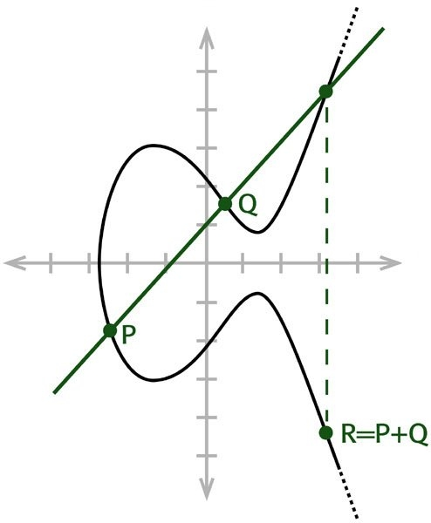
Security of Electronic Healthcare System …
Overview of Elliptic Curve Cryptography
An approach for implementation of public-key cryptography according to
the algebraic structure of elliptic curves over finite fields
An elliptic curve →
Main Operations → Point Multiplication, Point Addition, and Point Doubling
Elliptic Curve Discrete Logarithm Problem
Finding X in →
Advantages
Better performance
Low power consumption
Less memory usage

Slide 33
Implementation of A Security Technique
Common Part in Flow of ECC Software/Hardware – Level Implementation
Defining Main Parameters and Rules for ECC
Operations ¹
Choosing Algorithms for Desired Mathematical Operations
Implementing Point Addition and Point Doubling
This procedure can be
implemented using VHDL
or C++ language depending
on the type of implementation
Implementing the Primitive Field Operations ²
Implementing Point Multiplication
Selecting the Type of Coordinates for Representing the Elliptic Points

Slide 34
Implementation of A Security Technique …
ECC Software Level Evaluation
Memory Requirement Report
Using A Computer Architecture Simulator
(e.g. Gem5 or HASE)
Selecting A General-Purpose Processor ³
Running Time Report
Running the Executable Files of the Implemented Algorithms on the Processor
Instructions Per Cycle Report

Slide 35
Implementation of A Security Technique …
ECC Hardware – Level Implementation and Evaluation
Implementing Supplementary Hardware Blocks ⁴
Testing and Verification
(e.g. Synopsys TetraMAX)
Detectable Faults Report
Constructing the Main Hardware Description File
Floorplanning and Routing
(e.g. Cadence SoC Encounter)
Power Report
Simulation
(e.g. Cadence NCSim)
Power Extraction
(e.g. Synopsys Prime Time)
Temperature Report
Synthesis
(e.g. Synopsys Design Compiler)
Temperature Extraction
(e.g. HotSpot)
Area and Delay Report

Slide 36
Implementation of A Security Technique …
Comments on Flowcharts
Example for Main Parameters: Finite Field, Elliptic Curve, and Order of Field
Example for Primitive Field Operations: Addition, Multiplication, Inversion, Squaring, and Division
The instruction set architecture (ISA) of the chosen processor can be modified in order to improve the performance
Modification can be done by either adding or modifying instructions
Example for Supplementary Hardware Blocks: Interface, Storage, Parameter Generation, Arithmetic Logic Unit (ALU), Control, Security Scheme
Implementation of the other security techniques → Very similar to the presented one !

